Slide 1
UG/Knowledge Fusion
Knowledge Fusion for Programmers
Version 18.0.1.2

Slide 2
Introduction
Class Objectives
  Become familiar with the Knowledge Fusion language
  Become familiar with Knowledge Fusion functionality

Slide 3
Knowledge Fusion Language
Overview
  Interpreted
  Object oriented
  Declarative rather than procedural
  Access external knowledge bases
  Interface to other applications such as analysis and optimization packages
  Create geometric modeling features and expressions, utilize UDF’s, and build assemblies
    The language and the interactive system both create the identical set of UG objects
    Always in synch

Slide 4
Knowledge Fusion Language
What is a Knowledge Fusion Attribute?
  Much different than a UG attribute (totally unrelated)
  An attribute is basically a named value
  Closest thing in programming world is a “Variable.
  Can be a floating point number, an integer, a string, a point, a vector, an instance, a list of other attributes, etc.
  KF does not have arrays, but it has lists, which allows mixed data types within one list

Slide 5
Knowledge Fusion Language
What is a Knowledge Fusion Class?
  A class is the logic for creating an object
  A class is a collection of rules
  A class has parameters that receive values
  KF classes are similar to C++ and Java classes
  Classes are instantiated to create KF objects (instances)
  Classes can instantiate other classes forming an object tree

Slide 6
Knowledge Fusion Language
What is a Knowledge Fusion Object?
  Different than a UG object
  An object is an instance of a class
  An object is sometimes called an instance
  An instance has unique values for the class’s parameters
  A class can be instantiated multiple times yielding multiple unique instances

Slide 7
Knowledge Fusion Language
User Defined Classes
  Classes can be defined using a text editor (e.g. Vi)
  Classes are written in the UG/Knowledge Fusion language
  File name extension for class definition files is dfa
  DFA files can contain more than 1 class
    Only the first class is visible in the KF Navigator

Slide 8
Knowledge Fusion Language
DFA files
  Source code for user defined classes and functions
  Every DFA must start with
  #! UG/KF 17.0
  Single Line Comments #
    # Rest of line is a comment
  Multi-Line Comments
    Starts with #+
    Ends with #-
  After editing a DFA file while UG is running, do a Reload All (MB3 in the object tree)

Slide 9
Knowledge Fusion Language
DFA files
  An error occurs if a class name is repeated anywhere among all DFA files
  DFA file dependency
    DFA file content is not saved in part file
    Instantiated DFA file required to do a model update
    Send required DFA files with part files to other sites

Slide 10
Knowledge Fusion Language
Saving classes in part files
  saveClass?
    (Boolean) saveClass?: true;
  saveClassList
(List) saveClassList: {my_class1, my_class2};
(Child) child_1:
{
Class, if (a:) then my_class1 else my_class2,
…
};

Slide 11
Knowledge Fusion Language
Demand Driven
  Non-child rules will not be evaluated until they are required by another required rule
  Child rules are always evaluated
Declarative
  Rules can appear in any order within a DFA file
  Knowledge Fusion determines the order in which the rules are evaluated
  Similar to Spreadsheet
  Unlike “Procedural” languages

Slide 12
Knowledge Fusion Language
Basic syntax
Class Marker
Class Name
Mix-Ins
Parameter Attributes
DefClass: Door (ug_base_part);
(Number Parameter) door_height: 84;
(Number Parameter) door_width: 36;
(Child) block_1:
{
Class, ug_block,
height, door_height:,
width, door_width:
};
Default Values
Child Rule
Child Rule
Input Values

Slide 13
Knowledge Fusion Language
Attribute Syntax
Data Type
Behavorial Flags(s)
Attribute Name
Rule
(end of statement marker)
(Number Parameter) door_height: 84;
Rule containing a Reference
(Number) door_width: door_height: / 2;
Required Space

Slide 14
Knowledge Fusion Language
Child Rule Syntax
Attribute Type
Attribute Name
First name must be Class or Design
Class name is second
(Child) block_1:
{
Class, ug_block,
height, door_height:,
width, door_width:
};
List of Parameter Name and Value pairs
Semicolons or comas
Parameter names
(No colons)
Parameter values

Slide 15
Knowledge Fusion Language
Attribute Data Types
  Commonly Used Types
  Type Example
    Integer 22
    Number 3.14
    Point X,Y,Z coordinates
    Vector I,J,K direction
    List { 12, 3.14, “Test” }
    Frame Is a KF Coordinate system
    Boolean True or False
    String “Example”
    Instance Instance of any class
    Name ug_block

Slide 16
Knowledge Fusion Language
Behavioral Flags
  To explicitly control the way KF interprets and stores the values of attributes
  Commonly used behavior flags:
    Parameter – Tells the system that this attribute is a parameter to the class and might receive a value when the class is instantiated
    (Number Parameter) door_height: 84;
    UnCached - Tells the system not to store the value. It will be recomputed every time it is referenced (Default is cached)
    (Number UnCached) door_volume: rule...;
    No behavior flag is typical 95% of the time
    (Number) door_height: 84;
  Others discussed later
    Lookup, Method, Modifiable

Slide 17
Knowledge Fusion Language
Attribute and Class Names
  Can contain any alphabetic character, numeric character, "_" and "?”, as well as the special character "%"
  Not case sensitive
  Must begin with an alphabetic character or _ or %
depth, isSolid?, front_wall, point3, correct%

Slide 18
Knowledge Fusion Language
Hidden Classes
  If the a class name starts with a %, it will not appear in the KF Navigator
  Use this to hide classes from the user that are not supposed to be instantiated manually
Hidden Attributes
  An attribute name starting with a % will not appear in the KF Navigator, unless the attribute is created interactively using the KF Navigator

Slide 19
Knowledge Fusion Language
When referencing an attribute, always suffix it with a colon. (Referencing means use its value in the rule.)
  (Number) Rad: Dia: / 2;
  (Number) Rad: Dia / 2;
Colon means use value of attribute Dia
No colon means use the name Dia, which results in a run-time error if a name was not expected. KF does not check the data type until the rule is evaluated, which depending on logic, might not happen.

Slide 20
Knowledge Fusion Language
Rules or Formulas
  Engineering rules, or formulas, use numbers, names, strings, parts, etc.
  They also use operations, functions, references, methods, and conditions.
  They are used to specify values for attributes and default values for parameters.
  All formulas return one single value.

Slide 21
Knowledge Fusion Language
Statements
  Every statement ends with a semicolon
  (Number) Stress: 4*Load:/m_pi:/Dia:^2;
  Statements can span multiple source lines
  Every statement defines one value, which could be a list
  (List) Minimums: {MinYield:,MinUlt:,MinShear:};
  Attributes get their value once and cannot be changed while the “program” is running.
  For example, this cannot be done:
  A = B
  if (OK) then A = A + 1
  In KF, do it this way:
  (Number) A: if (OK:) then B:+1 else B:;

Slide 22
Knowledge Fusion Language
Arithmetic Expressions
  Include constants and the operators +, -, *, /, and ^
  Integers and numbers can be mixed
  Normal operator precedence used and parentheses can group operations
(33000 * horsepower:) / (2 * m_pi: * rpm:)

Slide 23
Knowledge Fusion Language
Geometric Expressions
  Point and vector operations
  The "." (period) for dot product
  Regular arithmetic operators for others; i.e., scalar * vector, etc.
    arc_1:center: + vector(width:; 0; 0) OK
    arc_1:center: + width: ERROR
    arc_1:center: * ratio: OK

Slide 24
Knowledge Fusion Language
Boolean Expressions
  The operators <, <=, >, >=, !=, &, and |
  Negation is accomplished with the minus (-) sign
  Parentheses around individual tests are not necessary but recommended
    if (a: > b:) | (a: = b:) & -(a: > c:)
    then expression1 else expression2;

Slide 25
Knowledge Fusion Language
String Expressions
  String constants are characters enclosed in double quotes
  Strings can be concatenated with a + and
  compared with =, <, >, <=, >=
    “select area, depth, flange_width, “ +
    “from i_beam_basic “ +
    “where designation = ‘” + designation: + “’”;

Slide 26
Knowledge Fusion Language
List Expressions
  List values are expressed by a list of expressions inside a pair of braces {} separated by commas or semicolons
  List members do not have to have the same data type
  Lists can be concatenated with a +
  Several built-in functions are available for manipulating lists
      {1, myGear:diameter:, 3, "Red", True, 4.234}

Slide 27
Knowledge Fusion Language
Functions Calls
  Take argument(s) and return a single value
  If more than one argument is required, they must be separated with a comma (,) or a semicolon (;)
      (Number) HowMany: length(ListOfNumbers:);
      (Part) SecondPart: nth(2; PartList:);
  Specify optional arguments using the argument name, followed by its value:
      ug_face_askPointParametersAtPoint(face:, point:, projection_vector, projVector:);

Slide 28
Knowledge Fusion Language
Popular Functions
  Geometry functions:
    localX(point), localY(point), localZ(point),
    point(x,y,z), vector(dx,dy,dz),
    point_(x,y,z,frame), vector_(dx,dy,dz,frame),
    dist(point, point)
  Math functions:
    cos, sin, tan, acos, asin, atan, sqrt, abs, ceiling, floor, max, min, round, mod
  π is an attribute named m_pi:
  String functions:
    format, length, substring
  List functions
    length(list), empty?(list), first(list), last(list), nth(integer,list)

Slide 29
Knowledge Fusion Language
Generic Classes
  Can be instantiated independently of any other classes
  It is not dependent on any other class for its values
  Its inputs are all the values necessary to instantiate it
  When you pass inputs to a generic class, you are creating an instance of that class
  It should be a goal to make every class as generic as possible
  Generic classes are re-usable and are the building blocks of efficient modular systems

Slide 30
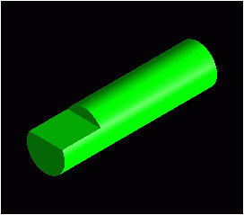
Knowledge Fusion Language
Code Example Walk-Through
  Create a class that builds this
  Input Parameters:
    Diameter
    Length
  Rules:
Diameter / 4
Length / 4

Slide 31
Knowledge Fusion Language
#! UG/KF 17.0
DefClass: Shaft (ug_base_part);
(Number Parameter) Dia: 1.0;
(Number Parameter) Len: 4.0;
(Number) flat_len: Len: / 4;
(Point) block_origin: point(-Dia:/2,0,Dia:/4);
(Child) Cyl:
{
Class, ug_cylinder,
Diameter, Dia:,
Height, Len:,
Direction, vector(0,1,0)
};
(Child) Flat:
{
Class, ug_block,
length, Dia:,
width, flat_len:,
height, Dia:,
origin, block_origin:,
target, {Cyl:},
operation, Subtract
};

Slide 32
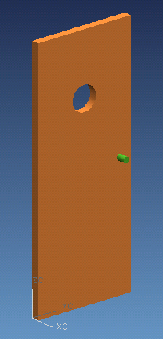
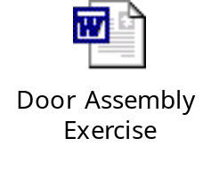
Exercise
Create a door assembly class

Slide 33
Knowledge Fusion Language
Referencing
  means of referring to other instances or their attributes
  an extremely powerful tool that allows relationships (both geometric and non-geometric) to be defined between various instance
  Example:
  (Point) block_origin: point(-Dia:,0,Dia:/4);

Slide 34
Knowledge Fusion Language
Reference Chains
  refer to values of other attributes
  (Number) KnobCost: Cabinet:CabinetDoor:Knob:Cost:;

Slide 35
Knowledge Fusion Language
Ref function
  ref(<expr returning an object>; ”<ref chain>”)
  Used to reference objects that are not specified as rules
  Objects that are being manipulated within a loop must be referenced using the ref function
  Typical example:
  (Number) totalWeight: loop{
  for $Part in children:;
  sum ref($Part; "weight:");
  };

Slide 36
Knowledge Fusion Language
Other ways to reference are with these key words:
  Child: refers to the current child object in a child or child list rule
  NHA: refers to the next higher ancestor, or parent
  Multiple NHA:’s may be used to progress further and further “up” the tree.
  Root: refers to the root of the current tree.
  Root: might be an object’s next higher ancestor or it might be ten levels up the object tree.

Slide 37
Knowledge Fusion Language
Information Passing
  Information passing refers to the methods by which information flows from object to object without the use of explicit reference chains, or referencing commands.
  The different methods of information passing are achieved with the use of behavioral flags.
  There are three basic information passing mechanisms:
    Parameter
    Lookup
    Descendant (default)

Slide 38
Knowledge Fusion Language
Parameter
  A parameter is used to explicitly pass information from a parent to a child.
  A parameter is an attribute whose value may be supplied by its parent, by the user, or by default.

Slide 39
Knowledge Fusion Language
DefClass: Letters (ug_base_part);
(Number Parameter) Length: 50;
(Number Parameter) Height: 50;
(Number Parameter) Thickness: 15;
(Child) L: {
Class; L;
length; Length:;
height; Height:;
thickness; Thickness:;
};
(Child) T: {
Class; T;
origin; point(Length:,0,0);
};
(Child) I: {
Class; I;
origin; point(Length:*2,0,0);
};
DefClass: L (ug_base_part);
(Number Parameter) Length: 30;
(Number Parameter) Height: 30;
(Number Parameter) Thickness: 10;
(Child) Vertical: {
Class; ug_block;
origin; point(0,0,0);
length; Length:/4;
width; Thickness:;
height; Height:;
};
(Child) Horizontal: {
Class; ug_block;
origin; point(0,0,0);
length; 3*Length:/4;
width; Thickness:;
height; Height:/4;
operation; Unite;
target; {Vertical:};
};

Slide 40
Knowledge Fusion Language
Lookup
  A lookup causes an attribute to look all the way up the ancestor tree to the root. If it encounters another attribute with the same name along the way, it takes on that attribute’s value.
  The value need not be explicitly passed down to the child. If the attribute exists in any ancestor, it will automatically assume the value in the nearest ancestor.
  If the attribute does not exist in any ancestor, a default value will be used if it is supplied.

Slide 41
Knowledge Fusion Language
DefClass: T (ug_base_part );
(Number Lookup) Length: 30;
(Number Lookup) Height: 30;
(Number Lookup) Thickness: 10;
(Point Parameter) origin:
Point(0,0,0);
(Child) Vertical: {
Class; ug_block;
origin; self:origin: +
vector(Length:/2,0,0);
length; Length:/4;
width; Thickness:;
height; Height:- Length:/4;
};
(Child) Horizontal: {
Class, ug_block;
origin, Vertical:origin: +
Vector(Vertical:Length:/2,
Vertical:width:/2,
Vertical:height:) -
Vector(child:length:/2,
child:width:/2,
0),
length, 3*Length:/4,
width, Thickness:,
height, Height:,
operation, Unite,
target, {Vertical:}
};
DefClass: Letters (ug_base_part);
(Number Parameter) Length: 50;
(Number Parameter) Height: 50;
(Number Parameter) Thickness: 15;
(Child) L: {
Class; L;
length; Length:;
height; Height:;
thickness; Thickness:;
};
(Child) T: {
Class; T;
origin; point(Length:,0,0);
};
(Child) I: {
Class; I;
origin; point(Length:*2,0,0);
};

Slide 42
Knowledge Fusion Language
Descendant Attributes
  Any attribute defined in a node is visible, and usable, by all of that node’s descendants.
  All attributes are descendant (i.e. you do not declare them descendant with a behavioral flag.)
  DO NOT rely on descendant attributes to pass attribute values. You will quickly lose control of your model. Use explicit parameter passing as a general rule.

Slide 43
Knowledge Fusion Language
DefClass: Letters (ug_base_part);
(Number Parameter) Length: 50;
(Number Parameter) Height: 50;
(Number Parameter) Thickness: 15;
(Child) L: {
Class; L;
length; Length:;
height; Height:;
thickness; Thickness:;
};
(Child) T: {
Class; T;
origin; point(Length:,0,0);
};
(Child) I: {
Class; I;
origin; point(Length:*2,0,0);
};
DefClass: I (ug_base_part);
(Point Parameter) origin:
point(0,0,0);
(Child) Vertical:
{
Class; ug_block;
origin; origin: +
vector(Length:*.75,0,0);
length; Thickness:;
height; Height:;
width; Length:/4;
};

Slide 44
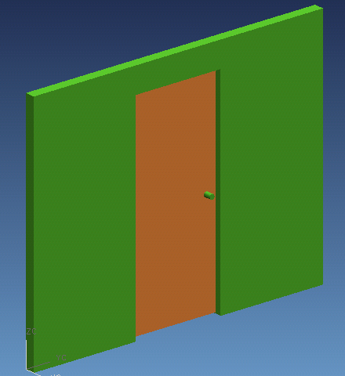

Exercise
Create a wall assembly
class that has a door

Slide 45
Knowledge Fusion Language
Reference Frames
  Knowledge Fusion's coordinate system
  Control the orientation of objects created with Knowledge Fusion
  Has an origin and three mutually orthogonal axes

Slide 46
Knowledge Fusion Language
Creating Frames
  Frames can be created with the following two functions:
    frameXY(point; X_vector; Y_vector):
      point the origin of the frame
      x_vector the direction of the positive x-axis
      y_vector the direction of the positive y-axis
    frame3Point(origin_point; X_point; Y_point)
      origin_point the origin of the frame
      x_point a point such that a vector from the origin point
      through this point defines the positive x-axis direction
      y_point a point such that a vector from the origin point
      through this point defines the positive y-axis direction

Slide 47
Knowledge Fusion Language
Using Frames
  Every UG class has a reference frame that is its local coordinate system. Rotating and/or translating this reference frame will rotate and/or translate your model.
  If no reference frame is specified, then the reference frame of the parent is inherited.
  If a reference frame is specified, then the orientation specified is relative to the orientation of the parent.
  Frames affect the numerical values used in point and vector functions. The values used for points and vectors are always in terms of the local reference frame.

Slide 48
Knowledge Fusion Language
Frame Example
DefClass: doors (ug_base_part);
(Vector) xvect1: vector(cos(-45), sin(-45), 0);
(Vector) yvect1: perpendicular(xvect1:);
(Child) open_door: {
Class; door;
referenceFrame;framexy(point(0,50,0),xvect1:,yvect1:);
};
(Child) closed_door: {
Class; door;
};

Slide 49
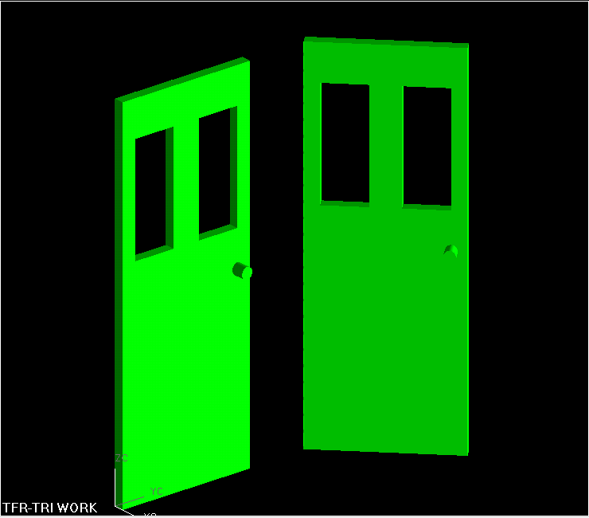
Knowledge Fusion Language
Frame Example

Slide 50
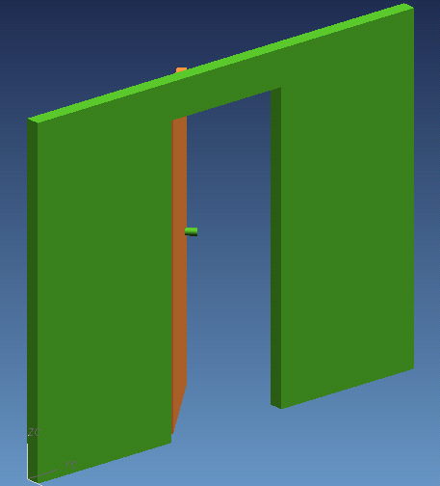
Exercise
Open the door in the wall
assembly

Slide 51
Knowledge Fusion Language
Conditionals
  Basic Syntax
if testExpression then expression1 else expression2;
Operator Logical Meaning
= equal to
!= not equal to
< less than
> greater than
<= less than or equal to
>= greater than or equal to
& and
| or
-, ! not

Slide 52
Knowledge Fusion Language
Conditionals
  Example
(Number Parameter) WidgetSize:;
(String) WidgetPartNumber:
if WidgetSize: = 1 then "W80000-1"
else if WidgetSize: = 2 then "W80000-2"
else if WidgetSize: = 3 then "W80000-3"
else "W80000-NEW";
This example shows how a multiple conditional can be used to determine a part number for the widget.

Slide 53
Using UG/Knowledge Fusion Programmatically
NullDesign
  The ability to remove, or add, classes to the model
    (Child) window1: {
    class; if Windows?: = TRUE then ug_block
    else NullDesign;
    };

Slide 54
Exercise
In the wall assembly, make the door optional and whether it is open or closed based on an input parameter
  (Name Parameter) door?: closed; # closed, open, or none
In the door assembly, make the color of the door dependent on the material
Material Color
"Oak" 11
"A242" 130
"Molded-21" 6
"302" 44
"Fiber-36" 39
"6061-T6" 37
default 2

Slide 55
Knowledge Fusion Language
Loops
  Rules
    A Loop must contain:
      At least one iterator clause
      At least one accumulator or terminator or special clause
    A Loop can contain:
      Multiple iterator clauses
      Assignment clauses
      Multiple accumulators and/or terminator clauses
    Whichever clause is satisfied first terminates the loop
    All loops must return a single value (could be a list)

Slide 56
Knowledge Fusion Language
Loops
  Basic Syntax
(data type) attribute_name: loop {
iterator clause(s);
assignment clause(s);
accumulator clause(s);
terminator clause;
special clause;
};

Slide 57
Knowledge Fusion Language
Loops
  Clauses
    Iterators
      for $variable from expression1;
      for $variable from expression1 to expression2;
      for $variable from expression1 to expression2 by expression3;
      for $variable In expression4;
    Assignment
      for $variable is expression;
      for $variable is expression then expression;
  Notes:
      expression1, 2, & 3 type is either number or integer
      expression4 type is list

Slide 58
Knowledge Fusion Language
Loops
  Clauses (cont)
    Accumulators
      append expression
      append expression into $variable
      collect expression
      collect expression into $variable
      if expression append expression
      if expression collect expression
      max_of expression
      max_of expression into $variable
      sum expression
      sum expression into $variable
  Notes
    Append creates a flat list
    Collect creates a list of lists

Slide 59
Knowledge Fusion Language
Loops
  Clauses (cont)
    Terminators
      if expression return expression
      Terminates the loop early
    Special
      do expression
      Executes a command (e.g. ug_printvalue, read, write)
      return is expression
      Sets the default return value
      with $variable is expression
      Initialize $variable. This statement is evaluated only once in the
      loop.
  Notes
    $variables can be of any type (number, list, string, etc.) and you don’t have to specify the type.

Slide 60
Knowledge Fusion Language
Loops
  Clauses that assign a value to the loop’s return value
    append expression;
    collect expression;
    if expression append expression;
    if expression collect expression;
    max_of expression;
    min_of expression;
    sum expression;
    if expression return expression;
    return is expression;
  Basically, any clause that does not specify which variable will receive the value

Slide 61
Knowledge Fusion Language
Loops
  More rules
    All variables defined inside a loop must start with a $ and do not end with a colon
    Inside a loop, you can reference existing attributes that are defined outside the loop
    Every statement inside a loop is evaluated in the sequence coded, i.e. it’s procedural, not declarative
    To create a child inside a loop, you must use the ug_createInstance function, since the normal (child) syntax is not valid inside a loop
    With nested loops, an inner loop can reference $variables created in the outer loop, but not vice versa
    The for...from clauses create values of type Number, not Integer. This implies that you must use the Floor function to coerce the value to an Integer if that’s the data type you need.

Slide 62
Knowledge Fusion Language
Loops
  Example 1
    Basic Loop
(Number) LoopValue: loop
{
for $a from 0 to 5; # Iterator
for $b is $a + 1; # Assignment
do ug_printValue($b); # Special clause
sum $b; # Accumulator
};
Since the accumulator (sum) isn’t assigned to a variable, it is therefore assigned to the loop’s return value.

Slide 63
Knowledge Fusion Language
Loops
  Example 2
    Find longest line in a list
(Number) LongestLineLength: loop{
for $a in children:;
for $b is ref($a;"length:");
max_of $b;
};
(part) LongestLine: loop{
for $a in children:;
if (ref($a;"length:") = LongestLineLength:)return $a;
};

Slide 64
Knowledge Fusion Language
Loops
  Example 3
    Parsing a lookup table
(Number Parameter) Load: 8000.0;
(List) BearingList: { # Input Data: List of lists
{"WEG3“, 2500},{"WEG4", 5500},
{"WEG5", 9400},{"WEG6", 13700}
};
(List) Bearing: loop{
for $list in BearingList:;
if Load: <= second($list) return $list;
return is {}; # Sets return value if load is too high
}; # if load = 8000, this returns {"WEG5", 9400, }
(String) BearingDesc: if empty?(Bearing:) then “”
else first(Bearing:);

Slide 65
Knowledge Fusion Language
Loops
  Example 4
    Nested Loops: Choose standard stock size having required cross sectional area or greater, while minimizing one dimension.
(number parameter) ReqdArea: 0.8;
(list) Stock: { 0.25, 0.5, 0.75, 1.0, 1.5, 2};
(list) LW_pair: loop{ # Returns list of 2 numbers, L & W
for $len in Stock:;
for $wid is loop{
for $wid1 in Stock:;
for $area is $wid1 * $len;
if $area > ReqdArea: return $wid1;
return is 0;
};
if $wid > 0 return {$len, $wid};
return is {};
};

Slide 66
Exercise
Create a class named support as follows:
  Given a tensile load and a maximum stress for the material, identify the diameter of the smallest standard round stock that does not yield under the given load. (Stress < Yield Stress)
    Input data:
      Load = 5600 lbs
      Material Yield Stress = 20,000 psi
    Formula:
      Stress = 4 * Load / ( π D² )
    Standard stock sizes (diameter in inches)
      0.25, 0.375, 0.5, 0.75, 1.0, 1.5, 2.0, 3.0
  Create a cylinder of the chosen standard diameter for visual feedback
  Note: Use m_pi: for π.

Slide 67
Knowledge Fusion Language
Expression Blocks
  A block of code that will be evaluated procedurally, i.e. every statement will be evaluated and in the order given
  An expression block must return a single value
  Local variables must start with a $
  Variable assignment syntax
  $var1 << expression;

Slide 68
Knowledge Fusion Language
Expression Blocks
  Basic Syntax
(data type) attribute_name:
@{
local_variable_1 << expression_1;
expression_n;
...
};

Slide 69
Knowledge Fusion Language
Expression Blocks
  Example 1
(list) read_in_file: @{
$a << openFile(“c:\work\input.txt”; read);
$b << readSimpleDataFile($a);
closeFile($a);
$b;
};
In this example, a text file is opened, read by Knowledge Fusion and then closed. The result of the read is a list of lists. This is a typical example of an operation that needs to be performed sequentially.

Slide 70
Knowledge Fusion Language
Expression Blocks
  Example 2
    Calculate fillet tangent points given three points p1, p2, p3 and radius.
(Vector) vec1: unitize(Vector2Points(p1:, p2:));
(Vector) vec2: unitize(Vector2Points(p3:, p2:));
(Number) dot: vec1: . vec2:;
(List) fillet_data:
if abs(dot:) < 0.99999 then
@{
$vec3 << unitize(vec1:+vec2:);
$a << rad: * sqrt((1+dot:)/(1-dot:));
$b << rad: * sqrt(2/(1-dot:));
$ang << acos(dot:)/2;
$ctr_pt << p2: - $b * $vec3;
$tan_p1 << p2: - $a * vec1:;
$tan_p2 << p2: - $a * vec2:;
{ $tan_p1, $tan_p2, $ctr_pt, p2:, $ang };
}
else {}; # Empty list, colinear points

Slide 71
Exercise
Read stock data from an ascii file
  Create a stock.dat file that contains the diameters given in the loop exercise
    0.25 0.375 0.5 0.75 1.0 1.5 2.0 3.0
  Edit your support class from the loop exercise
    Change the Stock rule from a hard-coded list to an expression block that reads the diameters from the stock.dat file
    NOTE: ReadSimpleDataFile returns a list of lists, where each sub-list is a line from the file.

Slide 72
Knowledge Fusion Language
Methods
  Method is a behavioral flag indicating that the rule is a method
  A method is a rule that calculates a value, using additional information passed to it as arguments. In this respect, it is analogous to a function
  Syntax
No space here!
(returnType Method) id:(type1 $var1; … ) @{ statements ... };
Formal argument list

Slide 73
Knowledge Fusion Language
Methods
  Example Definition
    (String Method) PartID:(Number $n,
    String $label)
    @{
    format(“%lf”, $n) + “ “ + $label + AAA:;
    };
  Example Usage
    (String) Label1: PartID:(12, “Offset”);
Discussed on next slide

Slide 74
Knowledge Fusion Language
Methods
  Methods differ from functions in two important ways:
    Different classes can have totally different implementations for the same method, allowing calling code to be generic
    Methods are executed in the context of the “target” instance, functions are executed in the context of the calling instance (see next bullet)
  Since methods are contained within a DefClass:
    they can be called with a reference chain
      (Number) value: Asm1:subasm2:My_Meth:(12,6);
    they can reference other attributes in the class like any other attribute
    In previous example, the value of AAA: is obtained from the class that defines the method, not the class that calls it

Slide 75
Exercise
Add a method to calculate the diameter given a tensile load and a maximum strength
  Edit your support class from the previous exercise
    Change the Material Yield Strength input to a Maximum Strength input with a default of 40,000
    Add a method named D that calculates the diameter:
    (F=load, S=maximum stress)
      D =
    Edit the loop to find the first diameter in the stock data that is greater than the calculated diameter
√
4F
πS

Slide 76
Knowledge Fusion Language
Functions
  Knowledge Fusion supports user-definable functions.
  Functions give the capability of encapsulating calculations that can be reused with different arguments.
  Functions are written using a text editor.
  Multiple functions can appear in the same file.
  The name of the file does not matter, but the extension should be ".dfa".
  Functions and classes can be intermixed in the same file.
  Knowledge Fusion searches for function files using its normal search path mechanism.
  Knowledge Fusion automatically loads functions as needed.

Slide 77
Knowledge Fusion Language
Functions
  Syntax
    Defun: id arglist block ReturnType;
  Example
Space here!
Defun: Midpoint (Point $p1; Point $p2)
@{
LinearInterpolation($p1; $p2; 0.5);
} Point;
Defun: LinearInterpolation (Point $p1;
Point $p2;
Number $factor)
@{
$p1 + (($p2 - $p1) * $factor);
} Point;

Slide 78
Knowledge Fusion Language
Functions
  Functions can have both required and optional arguments.
    Required Arguments
    Required arguments should appear first in the argument list. Required arguments must be provided in the same order as they appear in the formal argument list.
    Optional Arguments
    Optional arguments are enclosed inside parentheses. Optional arguments must follow required arguments, but may appear in any order. Defaults can be supplied.
    Variable Length Arguments
    Functions can have a variable number of arguments. This is done by using an ellipsis (“…”, three dots). The caller of the function can then provide any number of values and the values are supplied to the function as a single list.

Slide 79
Knowledge Fusion Language
Functions
  Optional Arguments Example
(Point) pt1: point(2,1.04,0);
(Point) pt2: point(1,1,0);
(Boolean)val1: VerticallyAligned?(pt1:, pt2:, tol; .5); # TRUE
(Boolean)val2: VerticallyAligned?(pt1:, pt2:, tol; .03); # FALSE
(Boolean)val3: VerticallyAligned?(pt1:, pt2:); # FALSE
Defun: VerticallyAligned? (Point $p1; Point $p2; Number ($tol, .001))
@{
$y1 << localy($p1);
$y2 << localy($p2);
abs($y2-$y1) < $tol;
} Boolean;

Slide 80
Knowledge Fusion Language
Functions
  Variable Number of Arguments Example
Defun: Average (Number … $nums)
@{
$total << loop {
for $item in $nums;
sum $item;
};
$total / length($nums);
} Number;
(Number) testAverage: Average(3,4,5,6,7); #5
(Number) costAverage: Average(1.5,2,7,1.65); #3.0375

Slide 81
Exercise
Write a function to calculate the diameter
  Edit your support class from the previous exercise
    Convert the D method to a function
      NOTE: Remember the function definition goes outside the class definition. Also remember to remove the : from the calling statement.

Slide 82
Knowledge Fusion Language
Child Lists
  A Child List yields a list of instances
  Requires specific parameters
    You must specify the pseudo-parameter called Quantity, which must be an integer (not a number)
  Each child’s parameters can be manipulated uniquely using child:index:, which is the counter for each child
  child:index: starts at 1, not 0

Slide 83
Knowledge Fusion Language
Child Lists
  Example
(Child List) ConcentricArcs:
{
Class; ug_arc;
Quantity; 10;
origin; point(0,0,0); radius; child:index: + 1.1;
};

Slide 84
Exercise
Create a set of cylinders from the diameters in the stock data
  Edit your support class from the previous exercise
    Add a child list rule that creates a cylinder with a diameter for each diameter in the stock data
      Space the cylinders 3 inches apart in the X direction starting
      at -11,5,0

Slide 85
Knowledge Fusion Language
Component classes (mixins)
  This capability is referred to as kind-of inheritance. A component class is sometimes called a mixin.
  Attributes of component classes may be redefined
  There can be many component classes for a given class.
  If there is more than one class and the classes have redundant attributes that are defined differently, then the class that is to the left, within the parentheses, takes precedence.
  Multiple mixins are separated by spaces.

Slide 86
Knowledge Fusion Language
Component classes (mixins)
  Example
    If class AAA is defined as:
      DefClass: AAA;
      (Number parameter) Dia: 12;
      (Number) Rad: Dia:/2;
    And class BBB is defined as:
      DefClass: BBB (AAA);
      (Number parameter) Height: 1.0;
      (Number) Volume: m_pi:*Rad:^2*Height:;
    Then class BBB looks like this inside KF:
      (Number Parameter) Dia: 12;
      (Number) Rad: Dia:/2;
      (Number Parameter) Height: 1.0;
      (Number) Volume: m_pi:*Rad:^2*Height:;

Slide 87
Exercise
Create a class named support_cylinder
  Mix in ug_cylinder
  Specify two inputs: tensileLoad and maximumStress
      Load = 5600
      Stress = 40,000
  Override the diameter attribute to be calculated from the tensile load and maximum strength using the equation given in the method exercise
      D =
√
4F
πS

Slide 88
Using UG/Knowledge Fusion Programmatically
ug_base_part
  ug_base_part is mixed into nearly every class and contains many basic attributes.
  ug_base_part provides a number of basic attributes to be included in all new classes.
  You should mix in ug_base_part in all of your classes unless you really know what you’re doing.

Slide 89
Using UG/Knowledge Fusion Programmatically
ug_mass_properties
  System class intended to be used as a convenience wrapper about the ug_AskMassProperties() function.
  Automatically unpacks the Mass_Properties list for the client.
  Calculates the mass properties relative to the referenceFrame.
  You may also call ug_AskMassProperties() directly from your class and unpack the values yourself.

Slide 90
Using UG/Knowledge Fusion Programmatically
ug_mass_properties
      (child) myblock: {
      class; ug_block;
      };
      (child) myblock_mp: {
      class; ug_mass_properties;
      features; {myblock:};
      };
      (number) myblock_volume: myblock_mp:volume:;

Slide 91
Knowledge Fusion Language
File I/O
  Access
    Access(String $path; Name $accessType)
  openFile
    openFile(String $path; Name $readwrite)
  closeFile
    closeFile(Any $file)

Slide 92
Knowledge Fusion Language
Readers
  KF provides a mechanism for reading data from ASCII text files.
    ReadInteger(Any $file)
    ReadNumber(Any $file)
    ReadLinesFromFile(Any $file; List $options)
    ReadSimpleDataFile(Any $file)

Slide 93
Knowledge Fusion Language
Readers
  ReadSimpleDataFile takes an open file handle from openFile and reads its contents.
  A list of lists is returned. Each sublist contains the data from a single line in the ASCII file. The list will contain numbers, names or strings.
  The delimeter is any white space. Blank lines and lines beginning with # are ignored.
  Strings are enclosed in double quotes and may never contain newline characters.
  All data that is not strings or numeric are parsed as names with all illegal characters replaced with underscores.

Slide 94
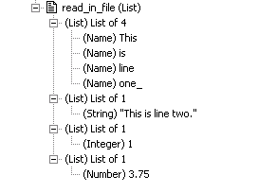
Knowledge Fusion Language
Readers
  Example
    Contents of "test.txt":
This is line one.
"This is line two."
1
3.75
(list) read_in_file: @{
$a << openFile(“c:\work\test.txt”; read);
$b << readSimpleDataFile($a);
closeFile($a);
$b;
};

Slide 95
Knowledge Fusion Language
Writers
  KF provides a mechanism for writing data to an ASCII text file.
  The function Write takes an open file handle from openFile and writes its contents.
  Format: Write(string; File)
  where “string” contains the data being written to the file specified by “File”.
  The “~” character is the escape character that allows the use of characters that are considered special to KF. It also provides a mechanism for inserting tabs, newlines, non-printing and extended-set characters.

Slide 96
Knowledge Fusion Language
Writers
Escape Sequence | Actual File Result
“To get ~”quotes~” in a string.” | To get “quotes” in a string.
“For other special characters ~~.” | For other special characters ~.
“For tabs ~t in the string.” | For tabs <tab> in the string.
“For a newline ~n character.” | For a newline <newline> character.
“For multiple ~n Newline ~n Characters.” | For multiple <newline> Newline <newline> Characters.
“Another way to get Newlines.” | Another way to get <newline> Newlines.
“Hexadecimal characters ~x40 .” | Hexadecimal characters @ .

Slide 97
Knowledge Fusion Language
Writers
  Example
(list) thickness: {5,6,7,8,9,10,11};
(list) stress: {80.64, 46.67, 29.3933, 19.6889, 13.8299, 10.081, 7.5701};
(integer) writer:
@{
$file << openfile(“c:\temp\bogus.txt"; write);
write("Thickness Stress" + "~n" +
" (in) (ksi)" + "~n~n"; $file);
loop {
for $idx from 1 to length(stress:); #iterator
for $stress is nth($idx, stress:); #assignment
for $thickness is nth($idx, thickness:); #assignment
do write(" "+ format("%2d";$thickness); $file) +
write(format("%12.2f"; $stress) + "~n"; $file);
};
closefile($file);
};

Slide 98
Knowledge Fusion Language
Writers
  Example (continued)
Thickness Stress
(in) (ksi)
5 80.64
6 46.67
7 29.39
8 19.69
9 13.83
10 10.08
11 7.57
12 5.83

Slide 99
Knowledge Fusion Language
UG/Open Interface
  Knowledge Fusion provides a facility for invoking a UG/Open C function from within a Knowledge Fusion rule.
  Such a function is defined within a DFA file using the CFUNC syntax.
  All data types are Knowledge Fusion data types, not C data types.
  Each CFUNC function must return a single value, which is a Knowledge Fusion data type.

Slide 100
Knowledge Fusion Language
UG/Open Interface
  UG/Open Function
DllExport extern void ask_color( UF_KF_value_t *data,
int num,
UF_KF_value_t *rv)
{
tag_t feature_tag;
tag_t body_tag;
UF_KF_instance_t instance;
UF_OBJ_disp_props_t obj_disp_props;
UF_initialize();
UF_KF_ask_instance( data[0], &instance );
UF_KF_ask_ug_object( instance, &feature_tag );
UF_MODL_ask_feat_body( feature_tag, &body_tag );
UF_OBJ_ask_display_properties ( body_tag, &obj_disp_props );
UF_KF_make_number ( obj_disp_props.color , rv );
}

Slide 101
Knowledge Fusion Language
UG/Open Interface
  KF Function Definition
#! UF/KF 17.0
Defun: ask_color ( instance $inst,
string ($libname, "d:\ufun\testsuite.dll"),
string ($funcname, "ask_color") )
@{ Cfunc("UF_KF_invoke_user_function"; "libufun");
} number;

Slide 102
Knowledge Fusion Language
UG/Open Interface
  KF Class Definition
#! UF/KF 17.0
DefClass: test (ug_base_part)
(child) block: { class, ug_block };
(number) body_color: ask_color(block:);

Slide 103
Knowledge Fusion Language
Language limits and restrictions
Length of a rule | 8192 characters
Length of name | 100 characters
Length of literal string | 511 characters
Number of mixins | 16
Number of arguments | 16
Nested levels of statement blocks | 10
Number of nested loops | 3
Statements in a block | 100
Variables in a block | 100
Clauses in a loop | 50
Number of defined names | 2²⁴ (about 16.7 million)
Depth of nested evaluations | 100

Slide 104
UG/Knowledge Fusion and Class Documentation
Class Documentation
  Sites set an environment variable to tell UG where the class documentation files are located
  Two possible environment variables
    UGII_KBE_DOC_URL
    UGII_KBE_DOC_DIR
  Set only one. If both are set, only the first one above will be used.

Slide 105
UG/Knowledge Fusion and Class Documentation
Configuration for Class Documentation
  UGII_KBE_DOC_URL
    Specifies a URL or a directory location for doc files
    NT shell execute
    Unix runs UGII_CSHELP_BROWSER script
    %s is substituted with class name. (Use
    %%s in Windows BAT files)
    Examples
      http://www-cyp/cgi-bin/kbe_doc?%s
      http://www/.../%s.html
      /appl/ugsite/.../class_doc/%s.html
      c:\appl\ugsite\...\class_doc\%s.html

Slide 106
UG/Knowledge Fusion and Class Documentation
Configuration for Class Documentation
  UGII_KBE_DOC_DIR
    Specifies a directory location for doc files
    NT launches application based on extension
    Unix displays the file in the UG listing window
    %s is substituted with class name . (Use
    double percents in Windows Bat files)
    <ext> can be .txt, .doc, .html, .ppt, etc.
    Examples
      /appl/ugsite/.../class_doc/%s.txt
      c:\appl\ugsite\...\class_doc\%s.html (Browser)
      c:\appl\ugsite\...\class_doc\%s.doc (MS-Word)

Slide 107
UG/Knowledge Pipeline
External Database Access
  An Open Database Connectivity (ODBC) interface that allows access to ODBC data sources
    Knowledge Fusion will query the database for requested information
    The user must initiate updates to the Knowledge Fusion model when changes are made to the database

Slide 108
UG/Knowledge Pipeline
Connecting to a database
  ug_odbc_database
    dsn A string specifying the "data source name", i.e., the database.
    userID A string specifying the user ID to log in to the database. Default is “ADMIN”.
    password A string specifying the password to log in to the database. Default is “”.
    loginTimeout The number of seconds to wait when logging in before getting an error. Default is 15.
    initialQueryTimeout The number of seconds to allow a query to run before getting an error. Default is 15.
    reuse? Reuse database connection flag. Default is TRUE.

Slide 109
UG/Knowledge Pipeline
Accessing data from a database
  ug_odbc_recordset
    database This must be a ug_odbc_database instance.
    type This is a name, either Dynaset or Snapshot.
    Dynaset recordsets can be modified.
    Snapshot recordsets are generally faster but cannot be modified.
    tableName A string containing the name of the table to select from.
    Fields A String that defines the fields to select. "*" selects all fields. To select multiple fields, separate field names by commas.
    Where A string that specifies a filter for records.
    orderBy A string that specifies how to sort the recordset.
    SQLstatement This is a string containing a complete SQL "select" statement that defines the data in the recordset.

Slide 110
UG/Knowledge Pipeline
ODBC Example
    Defclass: beam_basic_odbc (ug_base_part);
    (string parameter) designation: "3x5.7";
    (number) width: nth(3; beam_attrs:);
    (number) depth: nth(2; beam_attrs:);
    (List) beam_attrs: @{
    rec:moveFirst:();
    rec:GetRecord:();
    };
    (Child) db: {
    class; ug_odbc_database;
    dsn; "i_beams_basic";
    };
    (Child) rec: {
    class; ug_odbc_recordset;
    database; db:;
    sqlStatement; “select area, depth, flange_width, “ +
    “from i_beam_basic “ +
    “where designation = ‘” + designation: + “’”;
    };

Slide 111
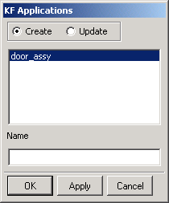
UIStyler Custom Dialogs
KF Applications
  Knowledge Fusion->Applications opens the Knowledge Fusion Applications dialog.
  This is the interface to dialogs created using the UI/Styler application.
  From this dialog you can access any user-created interface dialogs that have already been made and stored.

Slide 112
UIStyler Custom Dialogs
KF Applications
  The dialog features two radio buttons, Create and Update.
    Create mode
      Enter a name
      Select a class from the list of all possible classes for which the Knowledge Fusion can find a dialog file
    Update mode
      Select an instance from the list of those entries that could match a dialog file at some level of the reference chain OR select an object in the graphics area
  The OK button brings up the custom dialog created in UI/Styler.

Slide 113
UIStyler Custom Dialogs
Interaction with MenuScript
  Invoking a KF/Styler dialog from UG/Open MenuScript
    Set the ACTION in the menu file to be a class name with a .dfa file extension
MENU CUSTOM
BUTTON DOOR_ASSY
LABEL Door Assembly
ACTIONS doorassy.dfa
END OF MENU

Slide 114
UIStyler Custom Dialogs
Interaction with UIStyler Custom Dialogs
  The general approach used to connect UIStyler to Knowledge Fusion is through naming conventions.
  A UIStyler dialog is associated to a Knowledge Fusion class via the matching of the name of the class and the name of the dialog file.
    If the Knowledge Fusion class is called "doorassy", then the associated UIStyler dialog would be "doorassy.dlg".
  In the same manner, a parameter or rule inside a class is associated to a UIStyler interface object by name matching.
NOTE: Names in Knowledge Fusion are case insensitive, but since UNIX is a case sensitive system the Styler dialog names must be saved in lower case.

Slide 115
UIStyler Custom Dialogs
UIStyler Dialog Settings
  The dialog title and cue can be anything.
  The prefix name can be anything.
  The dialog type: Bottom
  The dialog launch method: All
  Navigation Options: Apply
  Selection: Off
  Allow Dialog to Resize: can be anything
  Callbacks: no changes required

Slide 116
UIStyler Custom Dialogs
UIStyler Interface Object Settings
  Object Identifier
    This is the name that is used to map from the UG/KF class to the user interface object.

Slide 117
UIStyler Custom Dialogs
Files
  No additional files are required for the Knowledge Fusion-UIStyler interface except for the .dlg file.
  The template "C" file and the header file that are generated by UIStyler can be deleted.
  The .dlg file should be placed in the appropriate directory for a user dialog:
    Current directory
    Same directory as the DFA file
    $UGII_USER_DIR/application
    $UGII_SITE_DIR/application
    $UGII_VENDOR_DIR/application

Slide 118
UIStyler Custom Dialogs
 | Number | Integer | String | Point Vector | Frame | List
Action Button | O | O | O | O | O | O
Bitmap |  |  | D
Button Layout | O | O | O | O | O
Integer |  | D/O | D/O
Label | D | D | D | D | D
Multi-line Text | D/O | D/O | D/O | D/O | D/O | D/O
Multi-select List
Option Menu |  | D/O | D/O
Radio Box |  | D/O | D/O
Real | D/O |  | D/O
Scale Integer |  | D/O | D/O
Scale Real | D/O |  | D/O
Scrolled Window
Selection Box |  | O | O
Separator
Single-select List |  | O | O
String | D/O | D/O | D/O | D/O | D/O | D/O
Toggle Button |  | D/O | D/O
Tool Palette |  | D/O | D/O
Wide String | D/O | D/O | D/O | D/O | D/O | D/O
Basic
translations
  D: KF->dialog
  O: dialog->KF

Slide 119
UIStyler Custom Dialogs
Extended translations
  Control specific attributes of the user interface objects from a Knowledge Fusion class
Attribute | Suffix | KF Data Type
Label | _LABEL | Integer, Number, String, Point, Vector
Sensitivity | _SENS | Integer
Visibility | _VISI | Integer
Scale Max Label | _MAXL | Integer, Number, String
Scale Max Limit | _MAX | Integer, Number
Scale Min Label | _MINL | Integer, Number, String
Scale Min Limit | _MIN | Integer, Number
Scale Precision | _PREC | Integer

Slide 120
UIStyler Custom Dialogs
 | Label | Sensitivity | Visibility | Min/Max | Precision
Action Button | Χ | Χ | Χ
Bitmap |  |  | Χ
Button Layout |  | Χ | Χ
Integer | Χ | Χ | Χ
Label |  | Χ | Χ
Multi-line Text | Χ | Χ | Χ
Multi-select List
Option Menu | Χ | Χ | Χ
Radio Box | Χ | Χ | Χ
Real | Χ | Χ | Χ
Scale Integer |  | Χ | Χ | Χ
Scale Real |  | Χ | Χ | Χ | Χ
Scrolled Window |  | Χ | Χ
Selection Box |  | Χ | Χ
Separator |  |  | Χ
Single-select List |  | Χ | Χ
String | Χ | Χ | Χ
Toggle Button | Χ | Χ | Χ
Tool Palette |  | Χ | Χ
Wide String | Χ | Χ | Χ
Extended
translations

Slide 121
UIStyler Custom Dialogs
Action buttons
  Display a dialog
  Evaluate a rule
    Any type other than those in the table
    Object identifier suffix "_FUNC" is required
    Only available in Update mode
KF Data Type | Object Identifier Suffix | Displayed Dialog
Point | _FUNC (optional) | Point subfunction
Vector | _FUNC (optional) | Vector subfunction
Frame | _FUNC (optional) | CSYS subfunction
String | _FILE (required) | File selection
List | _FUNC (optional) | Class selection

Slide 122
UIStyler Custom Dialogs
Specifying callbacks to control UI updates
  Item activate callback
    Refresh
      Takes the current contents of the dialog and uses that data to create or update the rule in KF
      Does not call the full UG update so geometry is not created or updated
      Reads back and displays any changes to values or presentation in the dialog
    Update
      Similar to Refresh, but the full UG update is called
      Works the same as the Apply button on the dialog

Slide 123
UIStyler Custom Dialogs
Specifying callbacks to control UI updates
  Dialog constructor callback
    Refresh
      Initial instance of the class is immediately created when the dialog first appears and the rules are evaluated in order to determine the state of the dialog
      Does not fully create the instance
      Pressing CANCEL button after only a refresh operation deletes the instance
    Update
      Similar to Refresh, but the full UG update is called
      Instance is fully created
      Any associated geometry is created

Slide 124
UIStyler Custom Dialogs
Specifying callbacks to control UI updates
  Dialog apply callback
    Create
      Default action for the Apply button is to create an instance of the class and then go into an edit mode
      Changes the behavior of the Apply button so that it continues to be in create mode
      A new object name will be generated by incrementing and appending a number to the original object name

Slide 125
UIStyler Custom Dialogs
Populating List Boxes and Option Menus
  Values that appear in a list box or option menu can be hard coded in the DLG file or
  Can be set dynamically by attributes in the DFA file
    Create an attribute in the DFA file with the same name as the UIStyler object identifier plus a "_LIST" suffix
    Enter Refresh in the dialog's Constructor callback

Slide 126

UIStyler Custom Dialogs
Integer and Label example
  Integer entry field: day_index
  Label: day_value
(Integer Parameter) day_index: 1;
(List) day_list: {"Sunday"; "Monday"; "Tuesday"; "Wednesday"};
(String) day_value: nth( day_index:; day_list:);

Slide 127

UIStyler Custom Dialogs
Point example
  Wide string entry field: start_point
  Action button: start_point_func
(Point Parameter) start_point: Point(0.0,0.0,0.0);

Slide 128
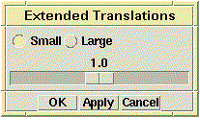
UIStyler Custom Dialogs
Extended translations example
  Radio box: scale_select
  Scale: scale_factor
(Integer Parameter) scale_select: 1;
(Number Parameter) scale_factor: 1.0;
(Number) scale_factor_min: 0.02;
(Number) scale_factor_max: if (scale_select: = 1) then 2.0
else 4.0;

Slide 129
Exercise
Create a UIStyler interface for the
door assembly class

Slide 130
Knowledge Pipeline
A programming environment for client/server applications that would like to work with Knowledge Fusion
Based on CORBA tools for inter-process communication
Geared toward allowing full access to Knowledge Fusion rules and the creation of applications that need to create, modify, delete or update those rules
Has some extensions to allow for manipulation of parts, the expression subsystem and the ability to read geometry information back to a client

Slide 131
Knowledge Pipeline
Working with CORBA
  3 main items that are released with UG for the Knowledge Pipeline
    UG/Open entry point which implements the CORBA server side of the Pipeline (the Knowledge Pipeline Engine)
    A set of libraries which contain the runtime system for CORBA
    A interface definition (IDL) file which describes the CORBA programming interface for the Knowledge Pipeline
  In order to do development with the Knowledge Pipeline you will need a CORBA development environment for client programming.

Slide 132
Knowledge Pipeline
Working with CORBA
  In order to do development with the Knowledge Pipeline you will need a CORBA development environment for client programming:
    An IDL translator
    Runtime libraries for CORBA
    Compilers and linkers
    A CORBA name server

Slide 133
Knowledge Pipeline
Development Steps
  Create or download the Pipeline Engine
  Translate the Pipeline IDL file into Java
  Create a client application:
    Open a connection to the Pipeline Engine
    Perform application tasks such as:
      Open or create UG part files.
      Query/Create/Update Knowledge Fusion rules and attributes
      Query/Create/Update the Expression subsystem
      Retrieve UG geometry for Java3d display on the client

Slide 134
Knowledge Pipeline
Runtime Environment
  Consists of three processes that can be running anywhere on the network
    The Knowledge Pipeline Engine
      A combination of a CORBA server and a UG/Open application
    A client application
      Can be written in a variety of languages from C, C++ and Java to Perl, TCL and Ada
    A CORBA name server
      A persistent process that is started and running prior to the invocation of the Pipeline Engine and client applications

Slide 135
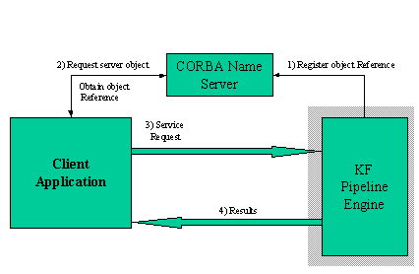
Knowledge Pipeline
Runtime Environment

Slide 136
Knowledge Pipeline
Runtime Environment
  Key steps
    Starting a name server
    Communicating the location of the name server to the Knowledge Pipeline Engine
    Communicating the location of the name server to the client application

Slide 137
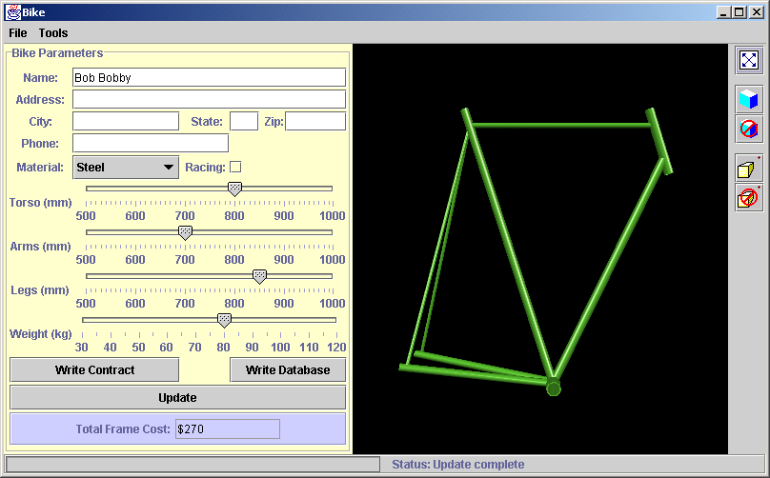
Knowledge Pipeline
Demo

Slide 138
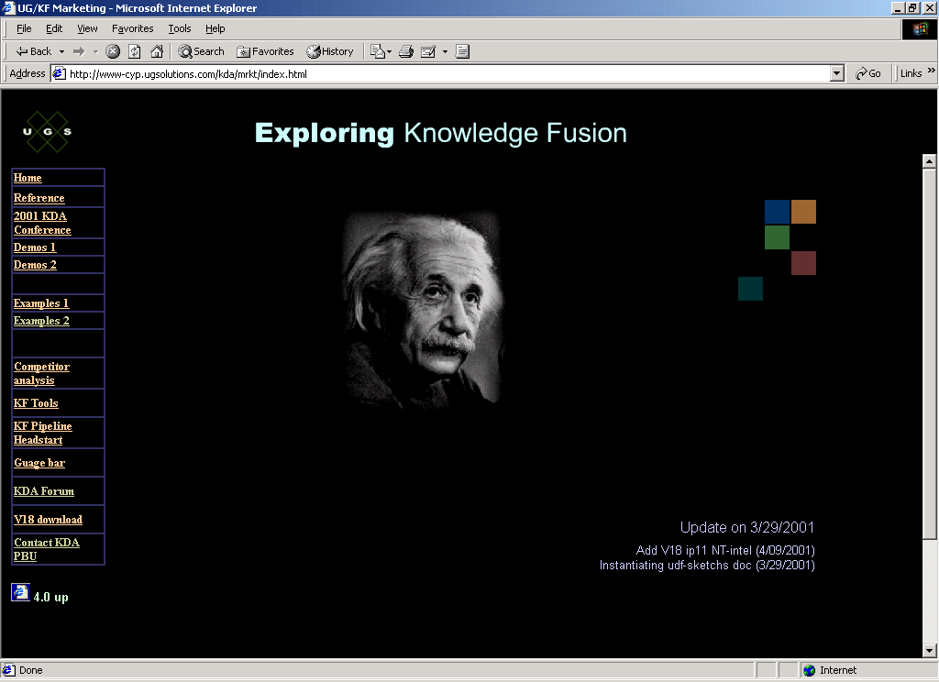
Web Site
http://www-cyp.ugsolutions.com/kda/mrkt/index.html

